Slide 1
Principles of OOP

Slide 2
Four main OOPs concepts in Java
Abstraction: Abstraction means using simple things to represent complexity. We all know how to turn the TV on, but we don’t need to know how it works in order to enjoy it.
Encapsulation: This is the practice of keeping fields within a class private, then providing access to them via public methods. It’s a protective barrier that keeps the data and code safe within the class itself. This way, we can re-use objects like code components or variables without allowing open access to the data system-wide.
Inheritance : This is a special feature of Object Oriented Programming in Java. It lets programmers create new classes that share some of the attributes of existing classes. This lets us build on previous work without reinventing the wheel.
Polymorphism : This Java OOPs concept lets programmers use the same word to mean different things in different contexts. One form of polymorphism in Java is method overloading. That’s when different meanings are implied by the code itself. The other form is method overriding.

Slide 3
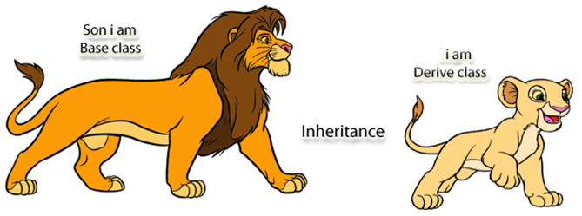
1. Inheritance
The idea behind inheritance in java is that you can create new classes that are built upon existing classes. When you inherit from an existing class, you can reuse methods and fields of parent class, and you can add new methods and fields also.
For Code Reusability.

Slide 4
Inheritance
superclass:
Inheritance is a fundamental Object Oriented concept
A class can be defined as a "subclass" of another class.
The subclass inherits all data attributes of its superclass
The subclass inherits all methods of its superclass
The subclass inherits all associations of its superclass
The subclass can:
Add new functionality
Use inherited functionality
Override inherited functionality
Person
- name: String
- dob: Date
subclass:
Employee
- employeeID: int
- salary: int
- startDate: Date

Slide 5
Inheritance – Example of how to use
Hourly_Employee
Attributes:
+name: String
+dob: Date
+hourRate: int
+hoursWork: int
Behaviors:
+getName
+setName
+getDOB
+setDOB
+getHourRate
+setHourRate
Permanent_Employee
Attributes:
+name: String
+dob: Date
+pension: int
Behaviors:
+getName
+setName
+getDOB
+setDOB
+getPension
+setPension
Temporary_Employee
Attributes:
+name: String
+dob: Date
+commission: int
Behaviors:
+getName
+setName
+getDOB
+setDOB
+getCommission
+setCommission

Slide 6
Inheritance – Example of how to use
Employee
Attributes:
+name: String
+dob: Date
Behaviors:
+getName
+setName
+getDOB
+setDOB
Hourly_Employee
Attributes:
+hourRate: int
+hoursWork: int
Behaviors:
+getHourRate
+setHourRate
Permanent_Employee
Attributes:
+pension: int
Behaviors:
+getPension
+setPension
Temporary_Employee
Attributes:
+commission: int
Behaviors:
+getCommission
+setCommission

Slide 7
Inheritance
When an object is created using new, the system must allocate enough memory to hold all its instance variables.
This includes any inherited instance variables
In this example, we can say that an Employee "is a kind of" Person.
An Employee object inherits all of the attributes, methods and associations of Person
Person
- name: String
- dob: Date
Person
name = “abc"
dob = Jan 13, 1954
Employee
name = “xyz"
dob = Mar 15, 1968
employeeID = 37518
salary = 65000
startDate = Dec 15, 2000
is a kind of
Employee
- employeeID: int
- salary: int
- startDate: Date

Slide 8
Inheritance Hierarchy
Each Java class has one (and only one) superclass
C++ allows for multiple inheritance
Inheritance creates a class hierarchy
Classes higher in the hierarchy are more general and more abstract
Classes lower in the hierarchy are more specific and concrete
There is no limit to the number of subclasses a class can have
There is no limit to the depth of the class tree.
Class
Class
Class
Class
Class
Class
Class
Class

Slide 9
Accessing function
class ParentClass {
public void fun(){
System.out.print("Hello word");
}
}
public class ChildClass {
public static void main(String args[]) {
ParentClass p = new ParentClass();
p.fun();
}
}

Slide 10
Quiz: Write the output of the following program
class ParentClass {
public void fun(){
System.out.print("Hello word");
}
}
public class ChildClass {
public static void main(String args[]) {
ChildClass c = new ChildClass();
c.fun();
}
}
Error: The method fun() is undefined for the type ChildClass

Slide 11
Using extends Keyword
package test;
class ParentClass {
int var=10;
}
public class ChildClass extends ParentClass {
public static void main(String args[]) {
ChildClass c = new ChildClass();
System.out.print(c.var); //accessing attribute of parent class
}
}
Output
10

Slide 12
Using extends Keyword
class ParentClass {
public void fun(){
System.out.print("Hello world");
}
}
public class ChildClass extends ParentClass{
public static void main(String args[]) {
ChildClass c = new ChildClass();
c.fun(); //accessing function of parent class
}
}
Output
Hello World

Slide 13
Example
class Employee{
float salary=40000;
}
class Programmer extends Employee{
int bonus=10000;
public static void main(String args[]){
Programmer p=new Programmer();
System.out.println("Programmer salary is:"+p.salary);
System.out.println("Bonus of Programmer is:"+p.bonus);
}
}
Output
Programmer salary is:40000.0
Bonus of programmer is:10000

Slide 14
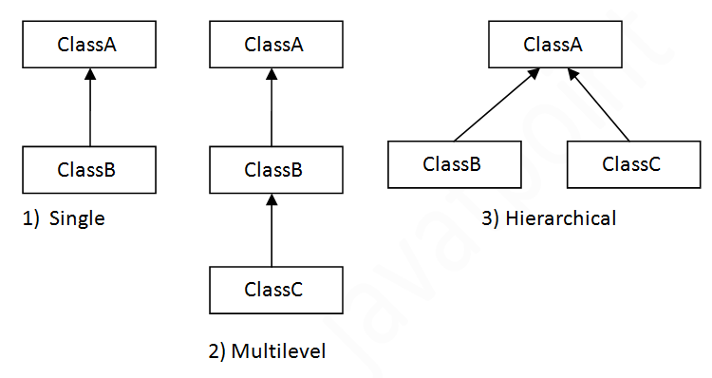
Types of inheritance in java

Slide 15
Single Inheritance Example
class Animal{
void eat(){
System.out.println("eating...");
}
}
class Dog extends Animal{
void bark(){
System.out.println("barking...");
}
}
class TestInheritance{
public static void main(String args[]){
Dog d=new Dog();
d.bark();
d.eat();
}
}
Output
barking...
eating...

Slide 16
Multilevel Inheritance Example
class Animal{
void eat(){
System.out.println("eating...");
}
}
class Dog extends Animal{
void bark(){
System.out.println("barking...");
}
}
class BabyDog extends Dog{
void weep(){
System.out.println("weeping...");
}
}
class TestInheritance2{
public static void main(String args[]){
BabyDog d=new BabyDog();
d.weep();
d.bark();
d.eat();
}
}
output
weeping...
barking...
eating...

Slide 17
Hierarchical Inheritance Example
class Animal{
void eat(){
System.out.println("eating...");
}
}
class Dog extends Animal{
void bark(){
System.out.println("barking...");
}
}
class Cat extends Animal{
void meow(){
System.out.println("meowing...");
}
}
class TestInheritance3{
public static void main(String args[]){
Cat c=new Cat();
c.meow();
c.eat();
//c.bark();//???
}
}
Output
meowing...
eating...

Slide 18
Super Keyword

Slide 19
Super Keyword
super is a keyword.
It is used inside a sub-class method definition to call a method defined in the super class.
The super keyword refers to the objects of immediate parent class.
Private methods of the super-class cannot be called.
Only public and protected methods can be called by the super keyword.
super is also used by class constructors to invoke constructors of its parent class.
To access the data members of parent class when both parent and child class have member with same name
To access the method of parent class when child class has overridden that method.

Slide 20
access the variables of parent class without super
class Superclass
{
int num = 100;
}
class Subclass extends Superclass
{
int num = 110;
void printNumber(){
System.out.println(num);
}
public static void main(String args[]){
Subclass obj= new Subclass();
obj.printNumber();
}
}
Output
110

Slide 21
super keyword to access the variables of parent class
class Superclass
{
int num = 100;
}
class Subclass extends Superclass
{
int num = 110; //Don’t use same variable name in super & sub classes
void printNumber(){
System.out.println(super.num);
}
public static void main(String args[]){
Subclass obj= new Subclass();
obj.printNumber();
}
}
Output
100

Slide 22
Function overriding
class ParentClass {
public void fun(){
System.out.print("Parent Class :Hello world");
}
}
public class ChildClass extends ParentClass{
public void fun(){
System.out.print("Child class :Hello world");
}
public static void main(String args[]) {
ChildClass c = new ChildClass();
c.fun();
}
}
Output
Child class: Hello world

Slide 23
Function overriding & usage of super
class ParentClass {
public void fun(){
System.out.print("Parent class :Hello world");}
}
}
public class ChildClass extends ParentClass{
public void fun(){
super.fun();
System.out.print("Child class :Hello world");
}
public static void main(String args[]) {
ChildClass c = new ChildClass();
c.fun();
}
}
Output
Parent class: Hello world
Child class: Hello world

Slide 24
super keyword to access the function of parent class – multi-level
class Grandparent{
public void fun() {
System.out.println("I am Grandparent");
}
}
class ParentClass extends Grandparent {
public void fun() {
super.fun();
System.out.println("I am parent class ");
}
}
public class ChildClass extends ParentClass{
public void fun(){
super.fun();
System.out.print("I am chid class");
}
public static void main(String args[]) {
ChildClass c = new ChildClass();
c.fun();
}
}
Output
I am Grandparent
I am parent class
I am child class

Slide 25
What if the child class is not overriding any method?
class Parentclass
{
void display(){
System.out.println("Parent class method");
}
}
class Subclass extends Parentclass
{
void printMsg(){
display();
}
public static void main(String args[]){
Subclass obj= new Subclass();
obj.printMsg();
}
}
//No need of super
Output
Parent class method

Slide 26
Constructor
class ParentClass {
ParentClass() {
System.out.println("Parent class constructor ");
}
}
public class ChildClass extends ParentClass{
ChildClass(){
System.out.print("Child class constructor ");
}
public static void main(String args[]) {
ChildClass c = new ChildClass();
}
}
Output
Parent class constructor
Child class constructor

Slide 27
Constructor & super
class ParentClass {
ParentClass() {
System.out.println("Parent class constructor ");
}
}
public class ChildClass extends ParentClass{
ChildClass(){
super(); // optional but if written should always be the 1st line
System.out.print("Child class constructor ");
}
public static void main(String args[]) {
ChildClass c = new ChildClass();
}
}
Output
Parent class constructor
Child class constructor

Slide 28
Constructor & super
class ParentClass {
ParentClass(int i) {
System.out.println("Parent class constructor with int parameter");
}
}
public class ChildClass extends ParentClass{
ChildClass(){
super(); // Error, no such constructor is available in parent
System.out.print("Child class constructor ");
}
public static void main(String args[]) {
ChildClass c = new ChildClass();
}
}

Slide 29
Constructor & super
class ParentClass {
ParentClass(int i) {
System.out.println("Parent class constructor with int parameter ");
}
}
public class ChildClass extends ParentClass{
ChildClass(){
super(10) ; // calling parameterized constructor of parent
System.out.print("Child class constructor ");
}
public static void main(String args[]) {
ChildClass c = new ChildClass();
}
}
Output
Parent class constructor with int parameter
Child class constructor

Slide 30
Access modifiers

Slide 31
Access modifiers
Access modifiers are those which are applied before data members or methods of a class. These are used to where to access and where not to access the data members or methods.
Private : Visible to the class only (private).
Public : Visible to the world
Default (not a keyword) : Visible to the package. No modifiers are needed
protected : Visible to the package and all subclasses .
Note: Default is not a keyword (like public, private, protected are keyword)
If we are not using private, protected and public keywords, then JVM is by default taking as default access modifiers.

Slide 32
Access modifiers (Public)
class testModifiers {
public int a=20;
public void show(){
System.out.println("Hello java");
}
}
public class demoModifiers {
public static void main(String args[]) {
testModifiers obj=new testModifiers();
System.out.println(obj.a);
obj.show();
}
}
Output
20
Hello java

Slide 33
Output ???
class testModifiers {
private int a=20;
private void show(){
System.out.println("Hello java");
}
}
public class demoModifiers{
public static void main(String args[]) {
testModifiers obj=new testModifiers();
System.out.println("Value of a is:" + obj.a);
obj.show();
}
}
Exception in thread "main" java.lang.Error: Unresolved compilation problems:
The field testModifiers.a is not visible
The method show() from the type testModifiers is not visible at test.demoModifiers.main(demoModifiers.java:18)

Slide 34
Output ???
class demoModifiers{
private int a=20;
private void show(){
System.out.println("Hello java");
}
public static void main(String args[])
{
demoModifiers obj=new demoModifiers();
System.out.println("Value of a"+obj.a);
obj.show();
}
}
Output :
Value of a20
Hello java

Slide 35
Access modifiers (Derived Class)
class testModifiers{
private int a=20;
private void show(){
System.out.println("Hello java");
}
public void access(){
System.out.println(a);
show();
}
}
public class demoModifiers extends testModifiers {
public static void main(String args[]) {
demoModifiers obj=new demoModifiers();
obj.access();
}
}
Output
20
Hello java

Slide 36
Access modifiers (Derived Class)
class testModifiers{
private int a=20;
private void show(){
System.out.println("Hello java");
}
public void access(){
System.out.println(a);
show();
}
}
public class demoModifiers extends testModifiers {
public static void main(String args[]) {
demoModifiers obj=new demoModifiers();
System.out.println(“a value is:” + obj.a);
obj.show();
}
}
Error: Can not access private data member or member function of parent class

Slide 37
Access modifiers (Derived Class)
class testModifiers{
protected int a=20;
private void show(){
System.out.println("Hello java");
}
public void access(){
System.out.println(a);
show();
}
}
public class demoModifiers extends testModifiers {
public static void main(String args[]) {
demoModifiers obj=new demoModifiers();
System.out.println(“a value is:” + obj.a);
}
}
Output:
a value is 20

